Slide 1
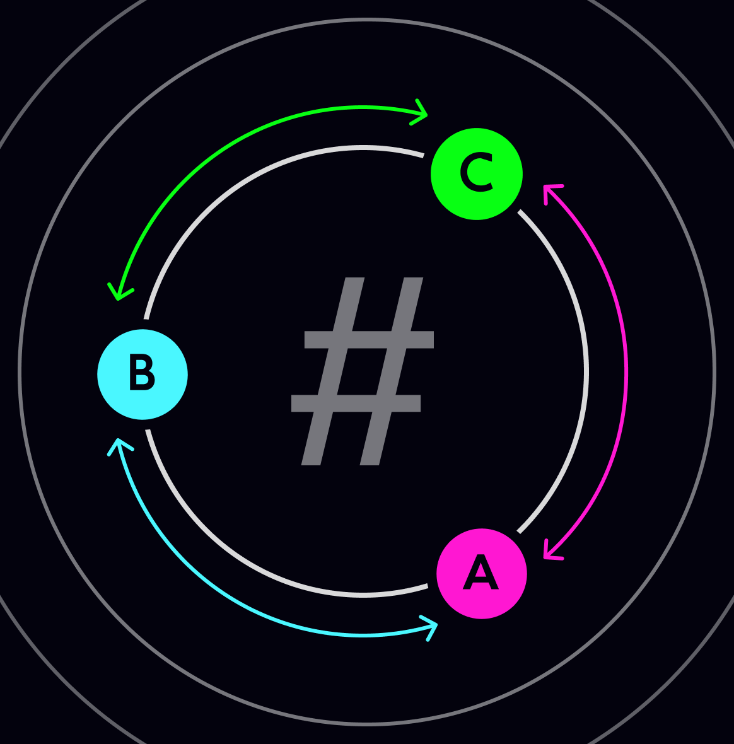
USER AUTHENTICATION USING DOUBLE HASHING
BATCH – B - 17
21AIE431 – Applied Cryptography

Slide 2
TEAM MEMBERS
01
Parthvi Manoj
02
Sakthi Swaroopan S
03
Sanjay Chidambaram
04
Taruneshwaran T
CB.EN.U4AIE21143
CB.EN.U4AIE21159
CB.EN.U4AIE21160
CB.EN.U4AIE21170
CRYPTO

Slide 3
MAJOR COMPONENTS
Double Hashing
Hash Salting
CRYPTO
Mercury is the closest planet to the Sun and the smallest one in the Solar System
Venus has a beautiful name and is the second planet from the Sun. It’s hot and poisonous

Slide 4
MAJOR COMPONENTS
Double Hashing
Hash Salting
Encryption
CRYPTO
It’s the closest planet to the Sun and the smallest in the Solar System
Venus has a beautiful name and is the second planet from the Sun
Despite being red, Mars is actually a cold place. It’s full of iron oxide dust

Slide 5

01
HASHING
CRYPTO

Slide 6

HASHING
Hashing is a process of converting input data (often of variable length) into a fixed-length string of characters, which is typically a hexadecimal number.
It's a one-way function, meaning you can't easily reverse it to obtain the original input.
Hash functions are commonly used for data indexing, password storage, and data integrity verification.

Slide 7

02
DOUBLE HASHING

Slide 8

CRYPTO
DOUBLE HASHING
Double hashing is a technique used in hash tables to handle collisions (when multiple items map to the same hash value).
It involves applying a second hash function to the original hash value if a collision occurs, and using the result as an offset to find an alternative slot in the hash table.
Double hashing helps reduce clustering and provides a more even distribution of hash table entries.

Slide 9
Hash Table Collision Resolution
Reduced Clustering
Even Distribution
Performance Optimization
Adaptive to Load Factors
Versatile Hash Function Selection
Space-Efficient
Deterministic and Repeatable
Cache-Friendly
FEATURES
CRYPTO

Slide 10
Applications of DOUBLE HASHING
Database Indexing
Caching
File Systems
Load Balancing
Network Routing
Password Storage
Compiler Symbol Tables
Hash-Based Data Structures
Spell Checkers
Web Search Engines
Database Query Optimization
Resource Allocation in Operating Systems
CRYPTO

Slide 11
03
HASH SALTING
CRYPTO
You can enter a subtitle here if you need it

Slide 12

Hash salting is a security technique used to enhance the security of password hashing.
It involves adding a random piece of data (the "salt") to the password before hashing it.
Salting ensures that even if two users have the same password, their hashed passwords will be different due to the unique salt.
This adds complexity and makes it more challenging for attackers to use precomputed tables (rainbow tables) to crack passwords.
CRYPTO

Slide 13
Applications of HASH SALTING
Password Storage
User Authentication
Cryptographic Protocols
Password-Based Key Derivation
Secure Cookies
Data Integrity Checking
Secure Storage of Personal Data
Cryptocurrency
Biometric Data Protection
Email and Document Signing
Password Recovery
Securing API Tokens

Slide 14
04
Current Prototype
The Progress So far…

Slide 15
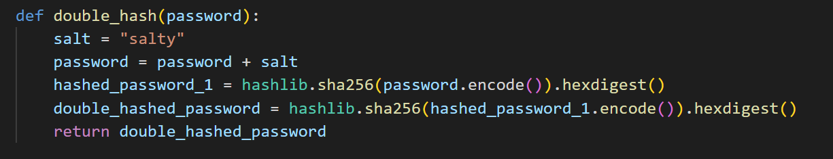
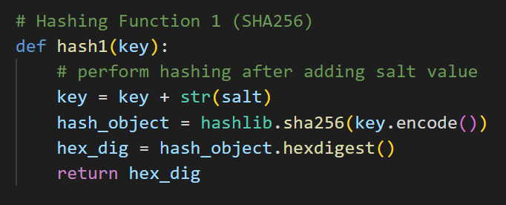
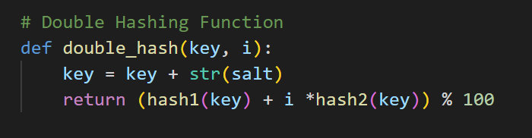
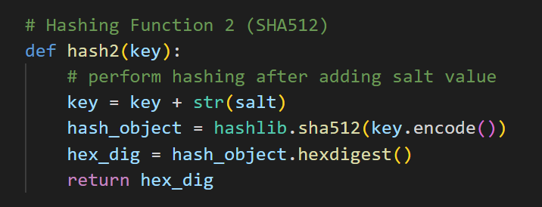
Functional Code
Current Working Code:
Potential Structure for Final code (Work in Progress)

Slide 16
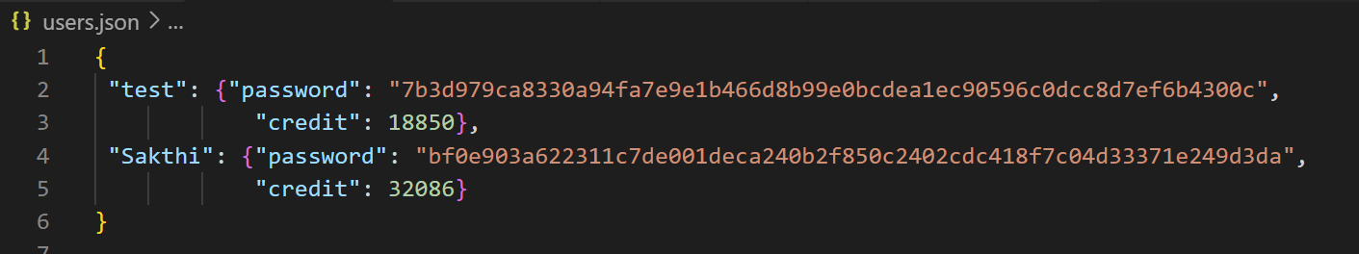
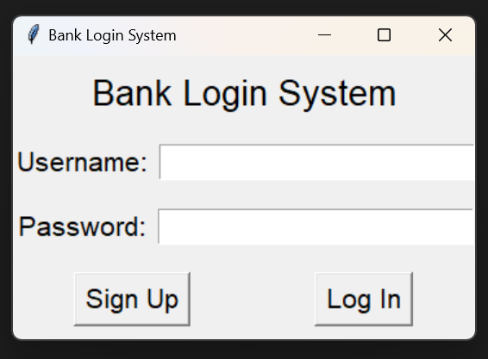
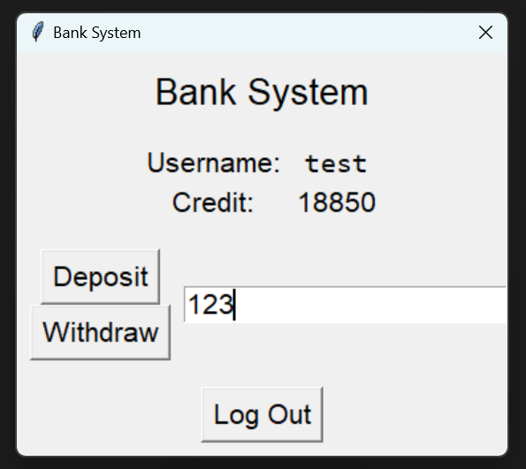
GUI for Mock-Up Login Application
JSON file to store data for prototype
GUI Mockup:

Slide 17
Thank You !
CRYPTO

